Slide 1

មជ្ឈមណ្ឌលកូរ៉េ សហ្វវែរ អេច អ ឌី
Korea Software HRD Center
Java Presentation
ឣ្នកប្រឹក្សាយោបល់: បណ្ឌិត​​ គីម​ ថេខ្យុង
ឣ្នកណែនំា: លោក លាង ប៊ុនរ៉ុង
លោក ដារ៉ា ពេញចិត្ត
www.kshrd.com.kh

Slide 2
ថ្នាក់ ភ្នំពេញ
ក្រុមទី ៤
ប្រធានបទ៖ Thread
សមាជិក
លោក ហ៊ុំ វ័ន
លោក ជាគីមហៅ
លោក ស៊ាង គង្គា
លោក ជឹម មីនា
លោក គីម ប៊ុនហុង

Slide 3
មាតិកា
ស្វែងយល់អំពី Thread
វិធីសាស្រ្តក្នុងការ implement thread
ស្វែងយល់អំពី Method of Thread

Slide 4


1. ស្វែងយល់អំពី Threads
Multitasking-Multithreading
ធ្វើកិច្ចការជាច្រើនក្នុងពេលតែមួយ - Multitasking
មានសមត្ថភាពដើម្បីចាប់ផ្តើមដំណើរការនៅកម្មវិធីជាច្រើន - Multithreading
Notes:
Most of us have mobile phones – sorry, I mean everyone of us. Now, image a situation where we are speaking on phone and still.. we will be able to eat the food and going further, some SMART people can even watch TV while these two activities.
As humans, we are good at multitasking. Our brains are capable of shifting the priorities between these tasks and still be able to perform all of them together with ease.
In the same fashion, computers are designed to perform multiple operations in parallel so that different PROCESSES can execute in the system. Just as we do, we are able to play the music in our computer and still be able to work on a document.

Slide 5


1. ស្វែងយល់អំពី Threads
Computer Game ជាឧទាហរណ៍ដល់ល្អសំរាប់ Multithreading ។
Notes:
Multithreading in Java gives the ability to execute code by different threads to perform tasks in parallel or as a separate task without waiting for other to complete.
Computer games are the best examples of the Multithreading concept. The ability to make different objects act on a platform is enabled with the concept of Multithreading.
Anyone who played Road Rash – you can see that there are different bike compete with you which are driven by the computer – They are nothing but threads running in the game application.

Slide 6
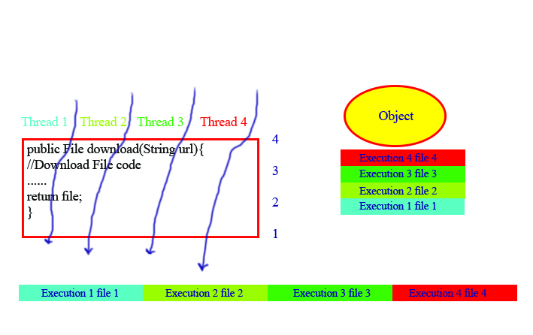
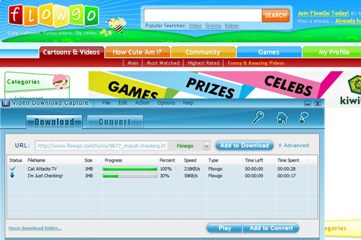
1. ស្វែងយល់អំពី Threads
Thread តើពួកវាជាអ្វីដែរ?
Notes:
Consider, we have a method which helps in downloading the files when you give the URL. Now, when you want to download four files, you execute this method for four times one after the other. But what if the files are too large and you want all the downloads to happen in parallel?
We should be able to execute this code in parallel for four times right?. That’s what threads are for. Threads are nothing but the execution engines which execute the code independent of each other.
Now when four threads execute the code in parallel, we can download four files in parallel. – Agreed?
You should understand a point here that there need not be four object for four threads.
Four threads can execute the code in a single object and even threads can create new Objects as well.

Slide 7
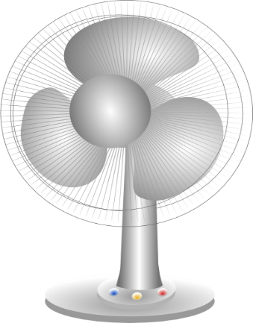


1. ស្វែងយល់អំពី Threads
Threads
Thread ប្រៀបដូចជាចរន្តអគ្គិសនីដែលចំលងតាមខ្សែទៅកាន់ឧបករណ៍ប្រើប្រាស់ ។
Notes:
So, when it comes to thread it is important that you should be able to imagine how things are getting executing to be able to debug the issues related to multithreading environment. So, let me take a simple real life example to explain how threads can be imagined.
Lets consider, we have three electrical devices, a fan, lamp and an Iron box.
Now think that these devices are connected to ports which are connected with multiple lines. When you power any line, these devices will start working and even power in all the lines will also make them work.
So, you can consider the power through different wires to be threads and electrical devices as objects.
I hope, I was able to use this example to ignite your imagination to make this topic about threads simple.

Slide 8





1. ស្វែងយល់អំពី Threads
Process and Threads
Process
Process
Process
Process
Notes:
Some of the people argue that process and threads are not different. But I think they are surely different.
You can think the process as an application running in your Operating system.
Consider a word application, It is a single process and when you type in word, a spell checker will keep working in the background to correct your words, this job can be considered as a thread.
So, you should understand that a process can have multiple threads in it.
So, a Java application running in a system is a process and can have multiple threads inside it.
Few more points to take you little deep into the threads concept and now,, we need to keep some points on top of mind.
First, as per definition – a thread is nothing but a thread of execution which executes the code. Then..
Every application has threads running in the background. Without threads, there will be NO application that will run.
When you use java class – your main method starts getting executed – It means that the JVM is creating a thread to start executing the code in main method and we call this method as Main thread.
It is the Operating System which schedules the threads to be processed by the Processor. So the scheduling behavior is dependent on the OS. Again there is a Thread Scheduler inside JVM which coordinates with OS scheduler.
Remember that there is nothing that is guaranteed when it comes to the thread execution. Do not bet that your thread will be executed at a time or so.. There is no guarantee..

Slide 9
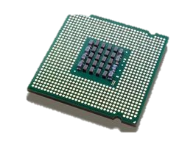
1. ស្វែងយល់អំពី Threads
Process and Threads
Thread
Thread
Thread
Thread
Notes:
Some of the people argue that process and threads are not different. But I think they are surely different.
You can think the process as an application running in your Operating system.
Consider a word application, It is a single process and when you type in word, a spell checker will keep working in the background to correct your words, this job can be considered as a thread.
So, you should understand that a process can have multiple threads in it.
So, a Java application running in a system is a process and can have multiple threads inside it.
Few more points to take you little deep into the threads concept and now,, we need to keep some points on top of mind.
First, as per definition – a thread is nothing but a thread of execution which executes the code. Then..
Every application has threads running in the background. Without threads, there will be NO application that will run.
When you use java class – your main method starts getting executed – It means that the JVM is creating a thread to start executing the code in main method and we call this method as Main thread.
It is the Operating System which schedules the threads to be processed by the Processor. So the scheduling behavior is dependent on the OS. Again there is a Thread Scheduler inside JVM which coordinates with OS scheduler.
Remember that there is nothing that is guaranteed when it comes to the thread execution. Do not bet that your thread will be executed at a time or so.. There is no guarantee..

Slide 10
2. វិធីសាស្ត្រក្នុងការ Implementation Thread
ដើម្បីធ្វើការ Implementation Thread នៅក្នុងភាសា Java យើងអាចធ្វើការ Implementation បានតាមពីររបៀបគឺ ៖
Implementation ចេញពី Class Thread
Implementation ចេញពី Interface Runnable

Slide 11
2. វិធីសាស្ត្រក្នុងការ Implementation Thread
2.1 ការ Implementation ដោយប្រើ Thread Class
គឺយើងគ្រាន់តែធ្វើការ Extend ចេញពី Class Thread ដែលស្ថិតក្នុង Package java.lang.Thread

Slide 12
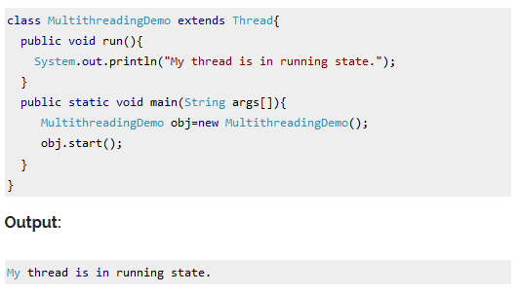
2. វិធីសាស្ត្រក្នុងការ Implementation Thread

Slide 13
2. វិធីសាស្ត្រក្នុងការ Implementation Thread
2.2 ការ Implementation ដោយប្រើ Runnable Interface
គឺយើងត្រូវតែធ្វើការ Implement ចេញពី Interface Runnable ដែលស្ថិតក្នុង Package java.lang.Runnable

Slide 14
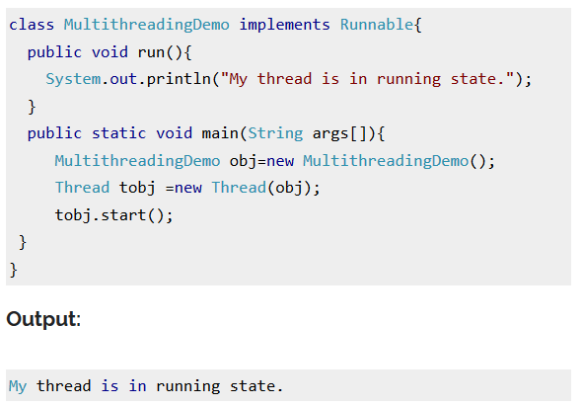
2. វិធីសាស្ត្រក្នុងការ Implementation Thread

Slide 15
2. វិធីសាស្ត្រក្នុងការ Implementation Thread
2.3 ភាពខុសគ្នារវាង Thread និង Runnable
Thread:
ដោយសារ Thread គឺជា Class ហើយ java មិន support អោយមាន multiple inheritance ដូច្នេះបើយើងធ្វើការ Extend Class របស់យើងចេញពី Class Thread គឺយើងមិនអាចធ្វើការ Extend ឬទទួលយកមរតកតពី Class ដទៃទៀតបានឡើយ។
Runnable:
ដោយសារ Runnable គឺជា Interface ហើយទោះបី java មិន support អោយមាន multiple inheritance ក៏ដោយក៏យើងអាចធ្វើអោយមានលក្ខណៈmultiple inheritance បានតាមរយៈ Interface បាន។ ដូច្នេះបើយើងធ្វើការ implement ចេញពី Interface Runnable យើងក៏អាចធ្វើការ implement ច្រើនតទៀតចេញពី Interface ផ្សេងៗ ហើយក៏អាចធ្វើការ Extend ចេញពី Class ណាមួយបានដែរ។

Slide 16
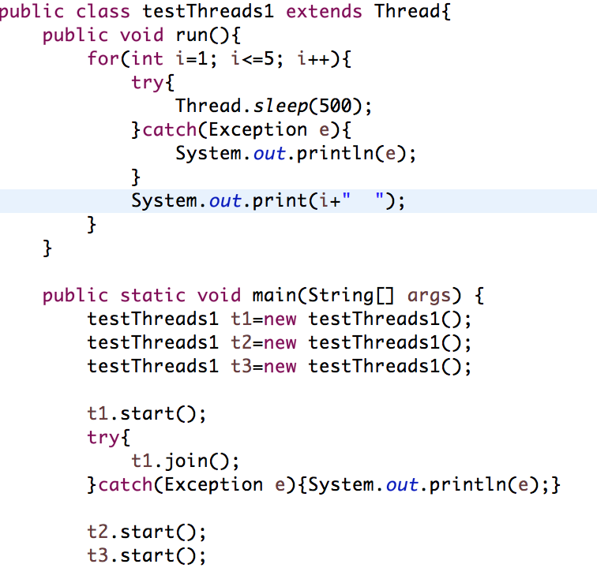
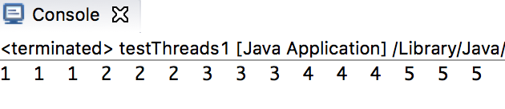
3.1 Sleep Method
3. ស្វែងយល់អំពី Method of Threads
Causes the currently executing thread to sleep
(temporarily cease execution)
There are 2 method
Static void sleep(long millis)
Static void sleep(long millis,int nanos)

Slide 17
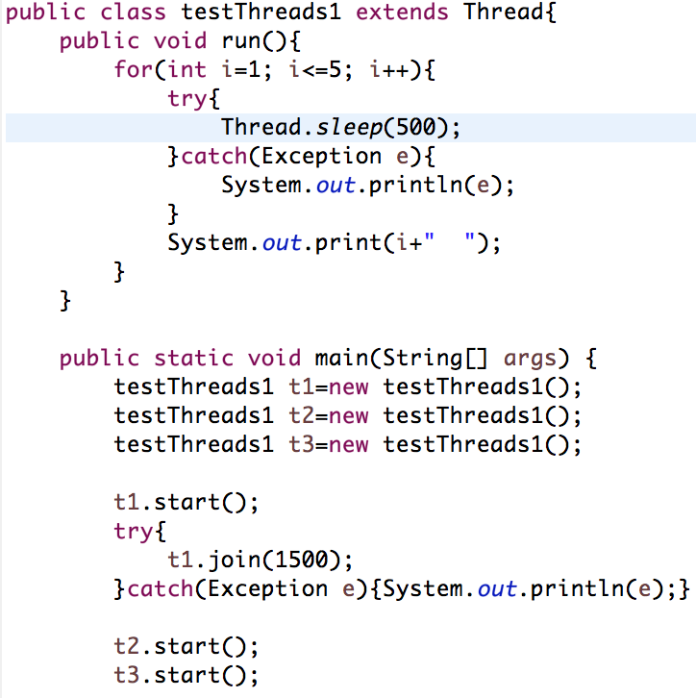
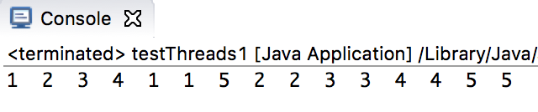
3. ស្វែងយល់អំពី Method of Threads
3.2 Join Method
Waits for this thread to die
There are 3 join method in Java
Void join()
Void join(long Millis)
Void join(long Millis, int Nanos)

Slide 18
Wait
Wait causees the current thread to wait until notify() invoke
There are 3 wait method
Void wait()
Void wait(long timeout)
Void wait(long timeout , int nanos)

Slide 19
Notify
Wakes up a single thread that is waiting on this object's monitor
There are 2 notify() method
Void notify()
Void notifyAll()

Slide 20
3. ស្វែងយល់អំពី Synchronization
1.1 តើអ្វីទៅជា Synchronization?
Synchronization នៅក្នុងភាសា Java គឺជា ការគ្រប់គ្រងនូវដំណើរការរបស់ threads ជាច្រើនទៅកាន់ប្រភពរួមមួយ។
វាគឺជាជម្រើសដ៏ប្រសើរមួយ បើយើងចង់អោយ thread តែមួយអាចចូលទៅដំណើរការ ប្រភពរួមមួយ។
យើងអាចនិយាយបានថា គឺជាវាគ្រប់គ្រងទៅលើ object នៃ thread មួយអោយដំណើរការចប់សិន ទើបវាអនុញ្ញាតអោយ object នៃ thread មួយទៀតអនុវត្តការងារតាមក្រោយ។
Notes:
A collection — sometimes called a container — is simply an object that groups multiple elements into a single unit. Collections are used to store, retrieve, manipulate, and communicate aggregate data. Typically, they represent data items that form a natural group, such as a poker hand (a collection of cards), a mail folder (a collection of letters), or a telephone directory (a mapping of names to phone numbers). If you have used the Java programming language — or just about any other programming language — you are already familiar with collections.

Slide 21


3. ស្វែងយល់អំពី Synchronization
Happybus.com
Total Seat:3
No.of Seats wanted:2
No.of Seats wanted:2
Notes:
Let us consider another example where we have a travel website happybus.com through which you can book your bus tickets.
Now there are only three seats left and two people are trying to book the tickets at the same time. Only one will be able to proceed and other will fail.
If you consider in both the cases, the trouble arises when different threads try to work on the same data at same time.
To avoid this problem, the code synchronization should be implemented which restricts multiple threads to work on the same code at the same time.
Now, Let us see a simple demo of code without thread safety. Given below is the code which demonstrates the Bus reservation example without Thread Safety.

Slide 22
1. ស្វែងយល់អំពី Synchronization
1.2 ការប្រើប្រាស់ Synchronization
យើងអាចប្រើប្រាស់ Synchronization Thread នេះបាន ២​ របៀបគឺ៖
Synchronized Method
Synchronized Block
Notes:
http://www.javatpoint.com/synchronization-in-java

Slide 23
1. ស្វែងយល់អំពី Synchronization
1.2 ការប្រើប្រាស់ Synchronization(ត)
ការប្រើប្រាស់Synchronized Keyword
class Table{
synchronized void printTable(int n){//synchronized method
for(int i=1;i<=5;i++){
System.out.println(n*i);
try{
Thread.sleep(400);
}catch(Exception e){System.out.println(e);}
}
}
}
Notes:
A collection — sometimes called a container — is simply an object that groups multiple elements into a single unit. Collections are used to store, retrieve, manipulate, and communicate aggregate data. Typically, they represent data items that form a natural group, such as a poker hand (a collection of cards), a mail folder (a collection of letters), or a telephone directory (a mapping of names to phone numbers). If you have used the Java programming language — or just about any other programming language — you are already familiar with collections.

Slide 24
1. ស្វែងយល់អំពី Synchronization
1.2 ការប្រើប្រាស់ Synchronization(ត)
ការប្រើប្រាស់Synchronized block
class Table{
void printTable(int n){
synchronized(this){//synchronized block
for(int i=1;i<=5;i++){
System.out.println(n*i);
try{
Thread.sleep(400);
}catch(Exception e){System.out.println(e);}
}
}
}//end of the method
}
Notes:
A collection — sometimes called a container — is simply an object that groups multiple elements into a single unit. Collections are used to store, retrieve, manipulate, and communicate aggregate data. Typically, they represent data items that form a natural group, such as a poker hand (a collection of cards), a mail folder (a collection of letters), or a telephone directory (a mapping of names to phone numbers). If you have used the Java programming language — or just about any other programming language — you are already familiar with collections.

Slide 25
ប្រភពឯកសារ
http://beginnersbook.com/2013/03/java-threads/

Slide 26
សូមអរគុណ!!!

